Slide 1
DevOps Metrics
SE489: DevOps Engineering

Slide 2
Outline
6 Steps to DevOps Success
How to Measure DevOps Success?
What are DevOps metrics?
Steps to Implementing DevOps ‘KPIs’
15 Key DevOps Metrics

Slide 3
6 Steps to DevOps Success

Slide 4
6 Steps to DevOps Success
Educate, educate, educate
Start slow and then expand
Show the bigger picture
Sell DevOps to the organization
Encourage and reward
Constantly evolve, improve, and grow

Slide 5
6 Steps to DevOps Success
Educate, educate, educate
  Changing the way people think and act is the most difficult and time consuming aspect of building a DevOps culture; it takes time to see the light and change behavior.
  The only answer to this is to educate and keep educating.
  A good opportunity to remove the bureaucracy and inflexibility of traditional IT that is acting as a barrier to development and begin your move to the cloud.

Slide 6
6 Steps to DevOps Success
Start slow and then expand
  Your staff might feel that if it is not broken, we do not need to fix it.
  Help them understand that while things are functioning, they can still be better.
  While building understanding across the enterprise, start progressing with one team.
  Analyze existing processes against the new principles, and see where DevOps practices can add value.
  Start from a simple problem first, optimizing and automating where appropriate.

Slide 7
6 Steps to DevOps Success
Show the bigger picture
  Remember that not all changes are unicorns and rainbows.
  There will be new processes and tooling, which means you need to change people’s habits.
  This might be good news for the organization but bad for a specific unit. For example, developers may lose some of their freedom when processes are cleared up making them a bit more restrictive.

Slide 8
6 Steps to DevOps Success
Sell DevOps to the organization
  To fight through natural human resistance of change it is important to frame DevOps in ways that people can see how it benefits them.
  You need to sell DevOps to all your teams and the management as well.
  Tell everyone about the tremendous gains they will receive with automation: less manual work, simplified processes, better visibility and trustworthy metrics.

Slide 9
6 Steps to DevOps Success
Encourage and reward
  Introducing the benefits alone might not be enough.
  Try to build a culture that encourages change, rewards new ideas, and fosters innovation.
  Whether you’re a software developer, operations manager, or inspirational leader, becoming a master of your craft takes time; you cannot turn into a great developer or manager overnight.
  You should start small, learn, and adapt to build your skills and senses.
  Motivate individuals or teams to take on new challenges, come up with development suggestions of their own, and be supportive to all ideas.

Slide 10
6 Steps to DevOps Success
Constantly evolve, improve, and grow
  Cultural change never has an end-point; it is an ever-evolving concept.
  When you begin your DevOps journey, you must realize that there is no final destination – and there never will be.
  You must constantly reinforce the DevOps message and empower your team to drive this cultural transformation through a solid support network and a sufficient toolset.

Slide 11
How to Measure DevOps Success?

Slide 12
How to Measure DevOps Success?
The goal of the DevOps model is to produce higher quality software faster and rapidly respond to changing requirements and technologies to keep the product on the leading edge.
If your team achieves this vision, you are enjoying the full benefits of the DevOps methodology.
The important question is “How do you know if you've reached this point?”
  Happy customers and end users
  Application performance
  etc.
Metrics help us uncover hidden issues and confirm the areas we're excelling in.

Slide 13
What are DevOps Metrics?
The ability to clearly and accurately assess DevOps metrics and performance benchmarks is critical to defining goals, improving efficiency, and tracking success.
The choice of key performance indicators for a DevOps initiative depends on the specific challenges and requirements of the company.
DevOps KPIs should provide a comprehensive view of business value and impact of the transformation.
The right performance metrics can evaluate the value of existing work done, and guide future process and technology decisions.

Slide 14
Characteristics of Useful DevOps Metrics
Five characteristics of a good DevOps indicator:
  Measurable—metrics must have standardized values that are consistent over time.
  Relevant—metrics should measure aspects that are important to the business.
  Reliable—team members cannot affect or “game” the measurement.
  Actionable—long-term analysis of the metric should provide insights into possible improvements in systems, workflows, strategies, etc.
  Traceable—the metrics should point directly to a root cause, not just allude to a general problem.

Slide 15
What are DevOps metrics?

Slide 16
What are DevOps metrics?
DevOps metrics are data points that directly reveal the performance of a DevOps software development pipeline and help quickly identify and remove any bottlenecks in the process.
These metrics can be used to track both technical capabilities and team processes.
Metrics allows DevOps teams to measure and assess collaborative workflows and track progress of achieving high-level goals including increased quality, faster release cycles, and improved application performance.

Slide 17
Steps to Implementing DevOps ‘KPIs’

Slide 18
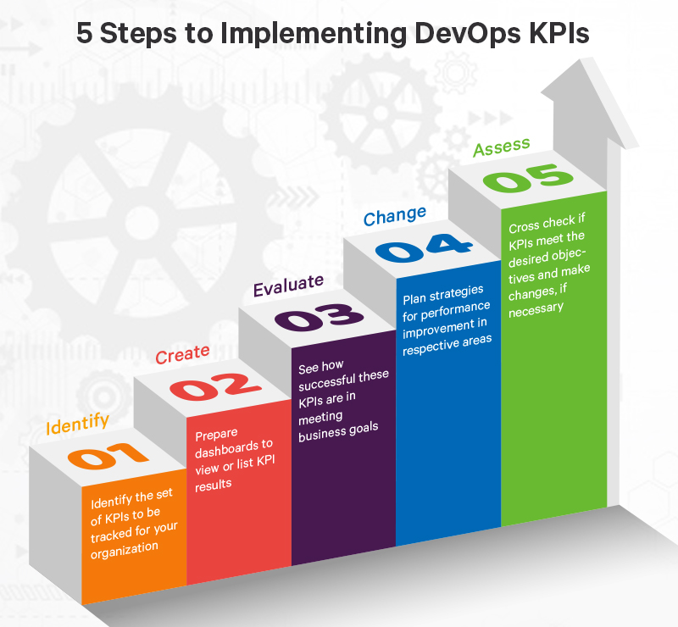
Steps to Implementing DevOps ‘KPIs’

Slide 19
Steps to Implementing DevOps ‘KPIs’
The implementation of DevOps KPIs is built on five steps:
  Identify
    Identify the set of KPIs to be tracked for your organization
  Create
    Prepare dashboards to view or list KPI results
  Evaluate
    See how successful these KPIs are in meeting business goals
  Change
    Plan strategies for performance improvement in respective areas
  Assess
    Cross-check if KPIs meet the desired objectives and make changes, if necessary

Slide 20
15 Key DevOps Metrics

Slide 21
15 Key DevOps Metrics
The following six metrics can be important for measuring DevOps performance and progress in most organizations
  Deployment frequency
  Change volume
  Deployment time
  Lead time
  Customer tickets
  Automated test pass %
  Defect escape rate
  Availability
  Service level agreements
  Failed deployments
  Error rates
  Application usage and traffic
  Application performance
  Mean time to detection (MTTD)
  Mean time to recovery (MTTR)

Slide 22
Deployment Frequency
The number of software deployments over a period of time.
It can be measured in a variety of ways, including automated deployment pipelines, API calls, and manual scripts.
This metric has to do with technical performance of the deployment pipeline, not frequency of delivery, because not all deployments are pushed to production. However, more frequent deployments can reduce errors associated with failed deployments, which affect overall customer satisfaction.

Slide 23
Change Volume
Change Lead Time — how much time we have from issuing a feature and deploy it to production?
Change Volume — how many stories/features and lines-of-code we push to production per deploy?

Slide 24
Deployment time
Tracking how long it takes to do an actual deployment is another good metric.
Tracking such things could help identify potential problems.
It is much easier to deploy more often when the task of actually doing it is quick.

Slide 25
Lead Time
The time it takes to implement, test, and deliver code.
To measure delivery time, the team must clearly define the start and end of the work (e.g. measurable time from code commitment to production deployment).
The goal is to speed up deployment through automation and reduce overall deployment time, for example by optimizing test integration and automation.

Slide 26
Customer Ticket Volume
This metric is a measure of end user satisfaction.
Bugs and errors can often bypass the testing phase and be detected by the end user.
Customers will then contact support and share their feedback.
Therefore, the number of customer tickets marked as problems or bugs are an important indicator of application reliability.
A large number of tickets indicates quality issues, while a small number indicates robustness of the application.

Slide 27
Automated test pass %
To increase velocity, it is highly recommended that your team makes extensive usage of unit and functional testing.
Since DevOps relies heavily on automation, tracking how well your automated tests work is a good DevOps metrics.
It is good to know how often code changes are causing your tests to break.

Slide 28
Defect Escape Rate
Even with a great DevOps pipeline, defects will occur.
In some cases, these defects may be detected during development or testing phases of the pipeline. But in the worst case, they will pass tests and be detected by end users.
The defect escape rate reflects the number of defects found in production during and after deployment.
It identifies cracks in the software development process—defects slide through these cracks and indicates that the quality process should be optimized and tightened.

Slide 29
Availability
The last thing you ever want is for your application to be down.
Depending on your type of application and how you deploy it, you may have a little downtime as part of scheduled maintenance.

Slide 30
Service level agreements
Most companies have some service level agreement (SLA) that they operate with.
It is also important that you track your compliance with your SLAs.
Even if there are no formal SLA, there probably are application requirements or expectations to be achieved.

Slide 31
Failed deployments
We all hope this never happens, but how often do your deployments cause an outage or major issues for your users?
Reversing a failed deployment is something we never want to do, but it is something you should always plan for.
If you have issues with failed deployments, be sure to track this metric over time.
This could also be seen as tracking mean time to failure (MTTF).

Slide 32
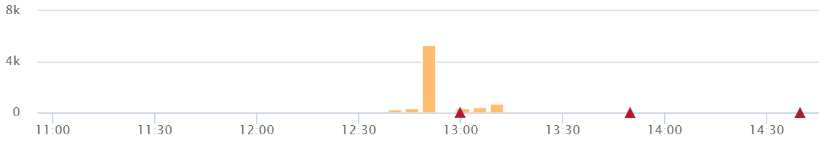
Error rates
Tracking error rates within your application is super important.
Not only are they an indicator of quality problems, but also ongoing performance and uptime related issues.
Good exception handling best practices are critical for good software.
  Bugs – Identify new exceptions being thrown in your code after a deployment
  Production issues – Capture issues with database connections, query timeouts, and other related issues.

Slide 33
Application usage & traffic
After a deployment, you want to see if the amount of transactions or users accessing your system looks normal.
If you suddenly have no traffic or a giant spike in traffic, something could be wrong.
The last thing you ever want to see is no traffic at all.
You could also see a spike in traffic if you are using microservices and one of your applications is causing a lot more traffic all of a sudden.

Slide 34
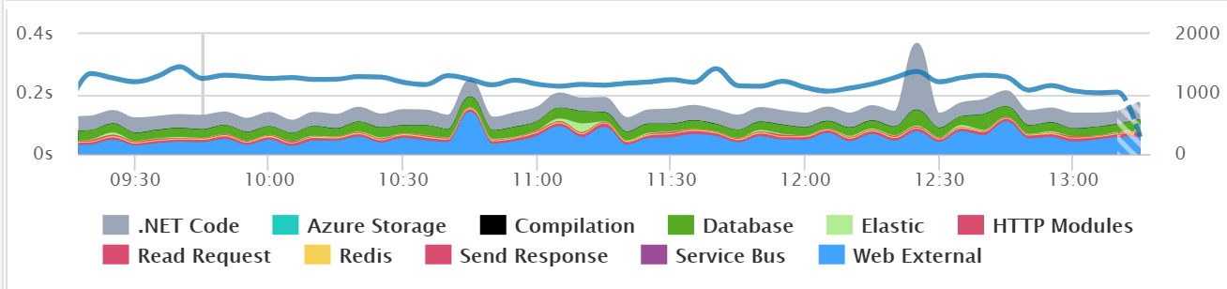
Application performance
Before you even do a deployment, you should use a tool to look for performance problems, hidden errors, and other issues.
During and after the deployment, you should also look for any changes in overall application performance.
It might be common after a deployment to see major changes in the usage of specific SQL queries, web service calls, and other application dependencies.

Slide 35
Mean time to detection (MTTD)
When problems do happen, it is important that you identify them quickly.
The last thing you want is to have a major partial or broad system outage and not know about it.
Having robust application monitoring and good coverage in place will help you detect issues quickly.
Once you detect them, you also have to fix them quickly!

Slide 36
Mean Time to Recovery (MTTR)
This indicator tracks how long it will take the organization to recover from failure.
It is a key business indicator because it reflects the ability to minimize disruption and recover normal operations quickly.
It is usually measured in minutes or hours, and can sometimes refer to time during business days, not clock time.
To reduce MTTR, it is important to have the right application monitoring tools, as well as effective collaboration between operations and developers, which can help you find root causes and deploy solutions quickly.

Slide 37
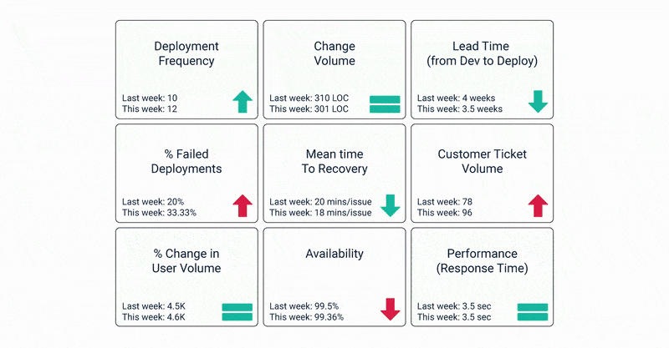
Measuring DevOps

Slide 38
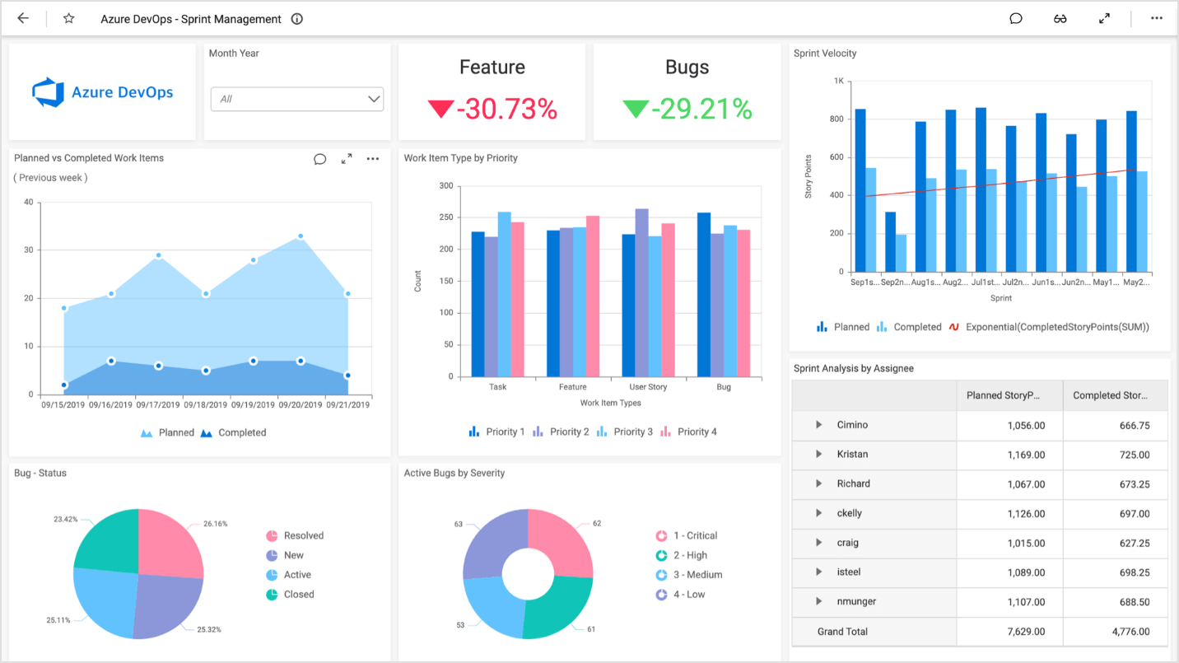
Measuring DevOps

